Slide 1
ONEWAY MANOVA: Environmentally Sensitive Car Example

Slide 2
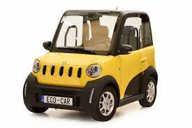
Business Challenge
You want to start a new car company that is gentle to the environment.
You want to call it the Ecospirit and want the brand to stand for supporting the spirit of the environment while getting people to where they need to go.

Slide 3
Business Challenge
You separate your potential customers into three different groups:
People with positive attitudes towards owning an eco-friendly car
People with neutral attitudes towards owning an eco-friendly car
People with negative attitudes towards owning an eco-friendly car

Slide 4
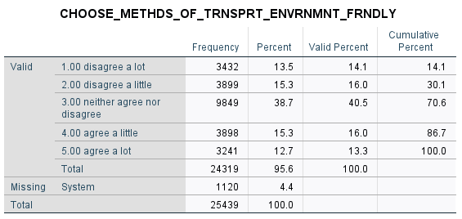
Business Challenge
Here are the freqs for our customer categories

Slide 5
Business Challenge
You think that your potential customers have the following qualities:
People have a duty to recycle
I consider myself a spiritual person
I buy the same products that celebrities use

Slide 6
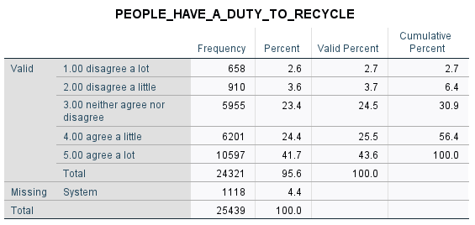
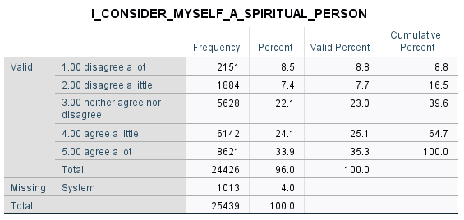
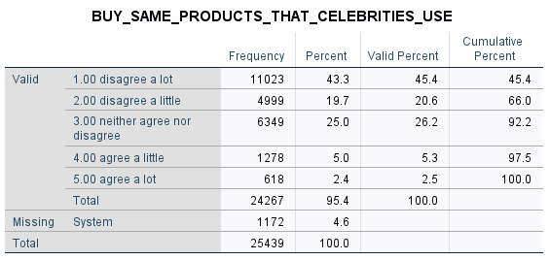
Business Challenge
Here are the frequencies for your customer characteristics

Slide 7
Grab the data and prep the independent variable
libname mylib "P:\“;
proc format;
value myenviron
1 = "negative attitude towards environment with car"
2 = "neutral attitude towards environment with car"
3 = "positive attitude towards environmentwith car";
data fancy;
set mylib.emba1;
/* set up pro/con/neutral recycle */
if CHOOSE_METHDS_OF_TRNSPRT_ENVRNMN < 3 then environcar =1;
if CHOOSE_METHDS_OF_TRNSPRT_ENVRNMN = 3 then environcar=2;
if CHOOSE_METHDS_OF_TRNSPRT_ENVRNMN > 3 then environcar=3;
label environ = 'people attitude toward environment with car';
format environcar myenviron.;
Point to SAS data set directory
Prep value labels for IV
Create temp data set fancy and put SAS data set emba1 in it
Make positive, negative
and neutral categories for IV
Label IV
Attach value labels to IV

Slide 8
Grab the data and prep the independent variable
libname mylib "P:\“;
proc format;
value myenviron
1 = "negative attitude towards environment with car"
2 = "neutral attitude towards environment with car"
3 = "positive attitude towards environmentwith car";
data fancy;
set mylib.emba1;
/* set up pro/con/neutral recycle */
if CHOOSE_METHDS_OF_TRNSPRT_ENVRNMN < 3 then environcar =1;
if CHOOSE_METHDS_OF_TRNSPRT_ENVRNMN = 3 then environcar=2;
if CHOOSE_METHDS_OF_TRNSPRT_ENVRNMN > 3 then environcar=3;
label environ = 'people attitude toward environment with car';
format environcar myenviron.;
Point to SAS data set directory
Prep value labels for IV
Create temp data set fancy and put SAS data set emba1 in it
Make positive, negative
and neutral categories for IV
Label IV
Attach value labels to IV

Slide 9
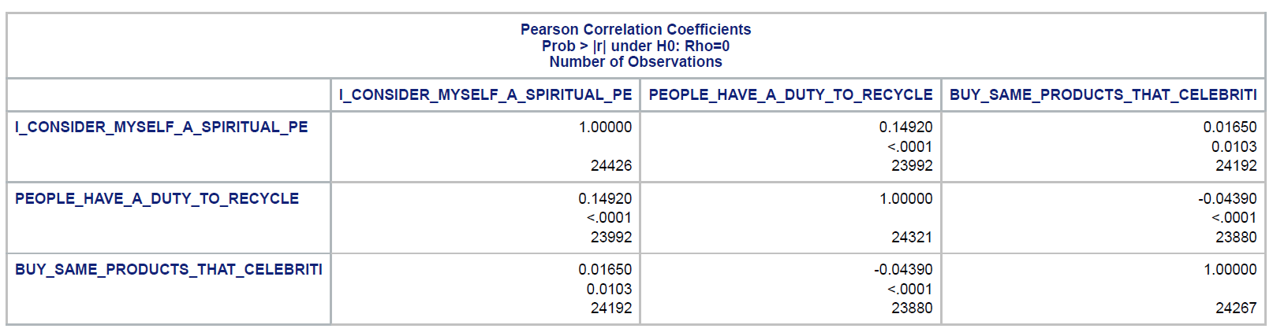
Sniff for Multi-collinearity
/* check for multicollinearity */
proc corr data=fancy;
var
I_CONSIDER_MYSELF_A_SPIRITUAL_PE
PEOPLE_HAVE_A_DUTY_TO_RECYCLE
BUY_SAME_PRODUCTS_THAT_CELEBRITI;

Slide 10
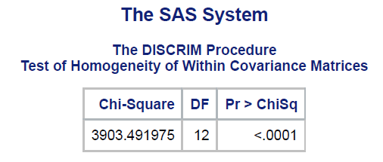
Sniff for Homogeneity of Covariance Matrices
Proc GLM that does the MANOVA does not have Box’s M test to test for equivalencies of variance matrices so we will use PROC DISCRIM to do that…
/* use proc discrim to do Box M test */
proc discrim data=fancy pool=test;
class environcar;
var
I_CONSIDER_MYSELF_A_SPIRITUAL_PE
PEOPLE_HAVE_A_DUTY_TO_RECYCLE
BUY_SAME_PRODUCTS_THAT_CELEBRITI;;
Run Box M test to test for equality of covariance matrices

Slide 11
Sniff for Homogeneity of Covariance Matrices
Box’s M is sensitive to sample size and so large sample sizes will often produce p values much less than .05. When sample sizes are large, homogeneity plays less of a serious threat to the validity of the analysis and so we should just view this test with a modicum of caution.

Slide 12
Run PROC GLM for Oneway MANOVA
Proc GLM that does the MANOVA does not have Box’s M test to test for equivalencies of variance matrices so we will use PROC DISCRIM to do that…
/* do manova with tukey post hoc tests */
proc glm data=fancy;
class environcar;
model
I_CONSIDER_MYSELF_A_SPIRITUAL_PE
PEOPLE_HAVE_A_DUTY_TO_RECYCLE
BUY_SAME_PRODUCTS_THAT_CELEBRITI = environcar;
means environcar / dunenett hovtest;
manova h=_all_ / printe printh;
run;
Proc GLM does the oneway MANOVA test in SAS
Here is our IV of attitude towards eco-friendly car
Here is our model for the oneway MANOVA
Means tests of groups with adjusted alphas for multiple groups
Run the manova – show me the between groups and error SCP matrices!

Slide 13
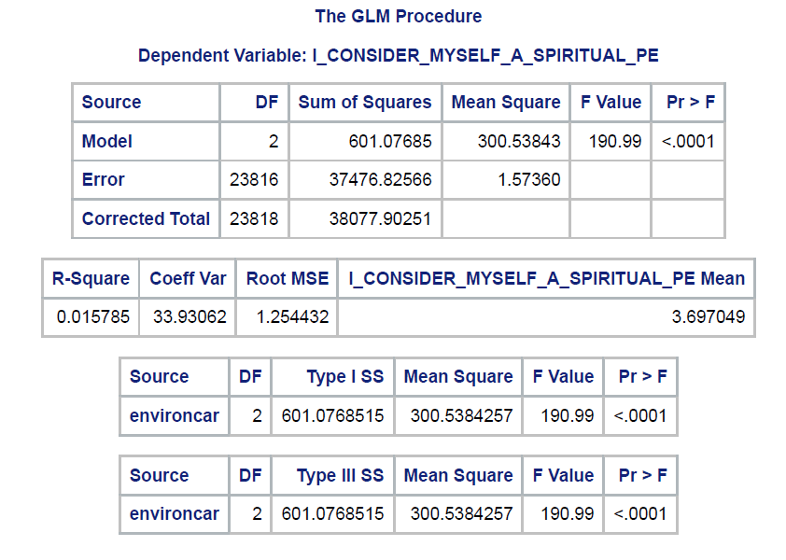
Univariate ANOVA test for Spiritual Person Q
Test is significant

Slide 14
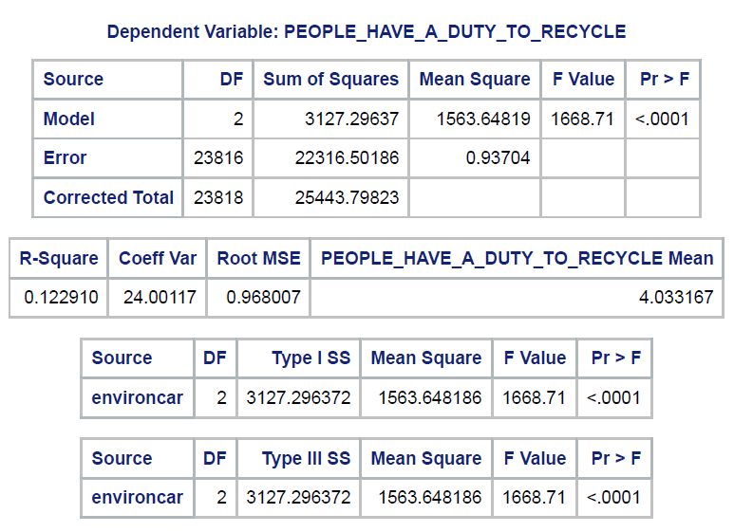
Univariate ANOVA test for Duty to Recycle
Test is significant

Slide 15
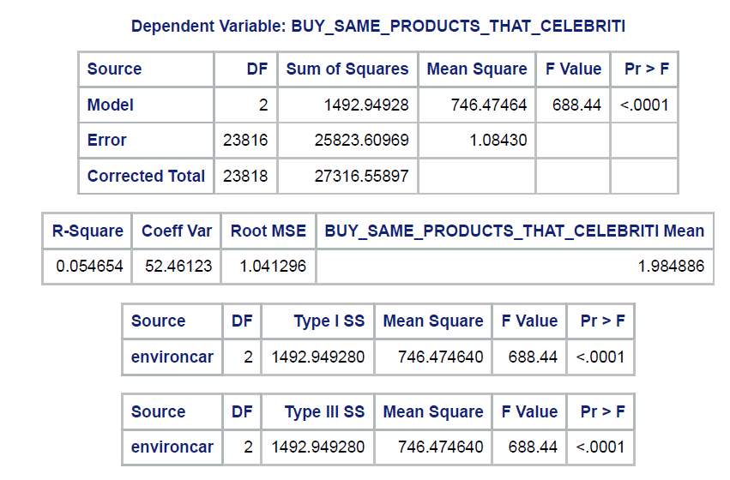
Univariate ANOVA test for Products Celebrities Use
Test is significant

Slide 16
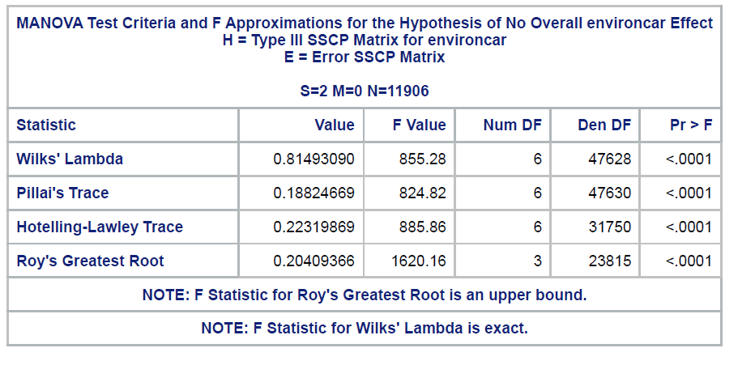
Oneway MANOVA test
We see here that Wilk’s Lamda as well as the rest of the tests suggest that there are likely differences in means across one or more of the dependent variables in the MANOVA.
Tests are significant

Slide 17
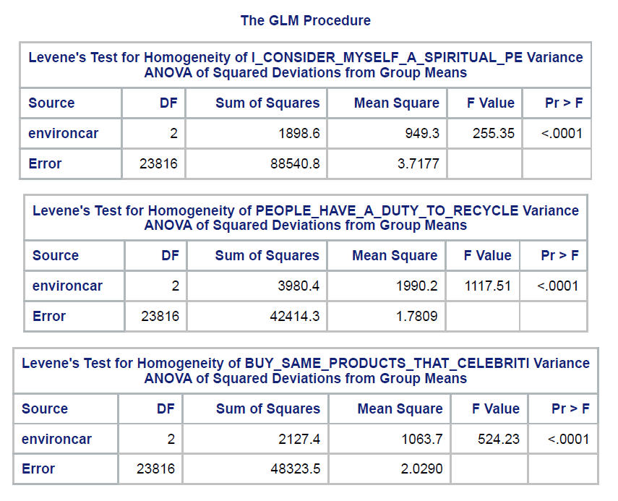
Univariate Levine Tests for Equal Variances Across Groups
Not surprising considering the result from Box’s M test. So this will figure in when choosing a multiple group comparison test in the next slide…We will have to use a test designed for unequal variances…

Slide 18
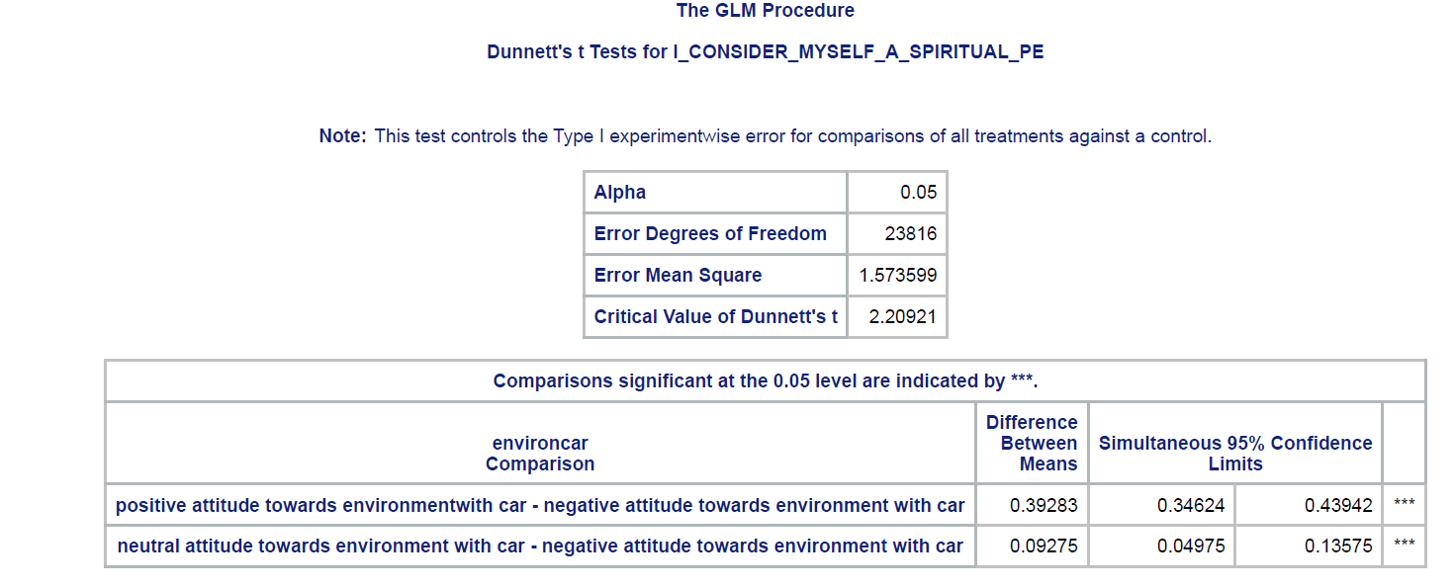
Multiple Group Comparison Tests
We see that two of the three possible comparisons for the three categories of the IV are significant for the dependent variable I consider myself a spiritual person. Note that the alpha levels are adjusted for tests. Also note that we are using Dunnett’s test because of the unequal variances between groups.

Slide 19
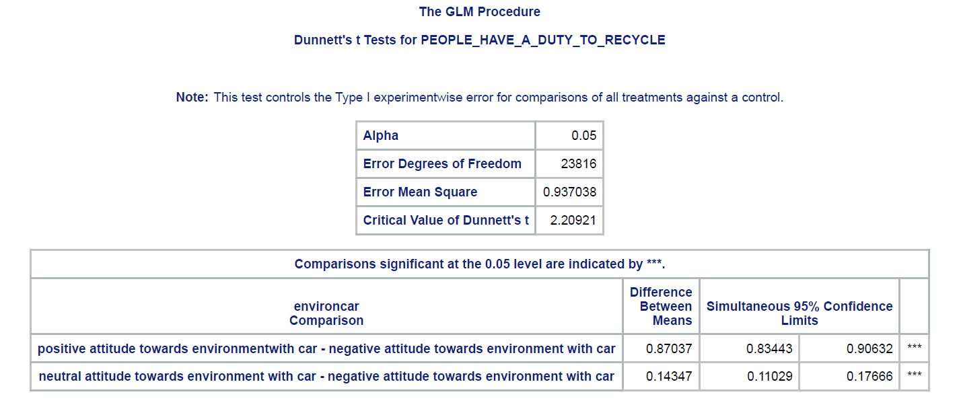
Multiple Group Comparison Tests
We see that two of the three possible comparisons for the three categories of the IV are significant for the dependent variable duty to recycle. Note that the alpha levels are adjusted for tests. Also note that we are using Dunnett’s test because of the unequal variances between groups.

Slide 20
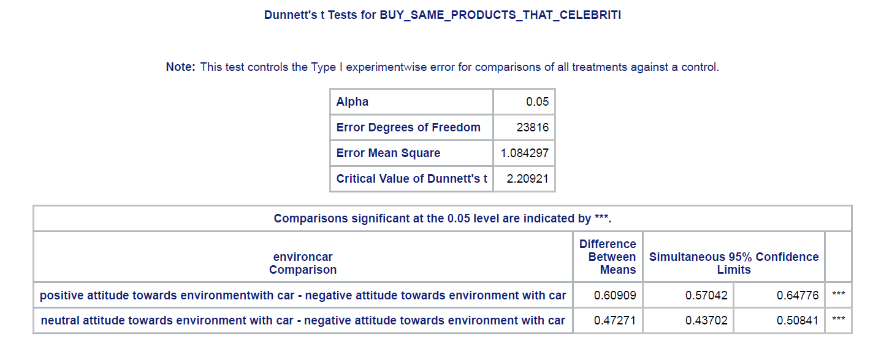
Multiple Group Comparison Tests
We see that two of the three possible comparisons for the three categories of the IV are significant for the dependent variable buy the ame products as celebrities. Note that the alpha levels are adjusted for tests. Also note that we are using Dunnett’s test because of the unequal variances between groups.

Slide 21
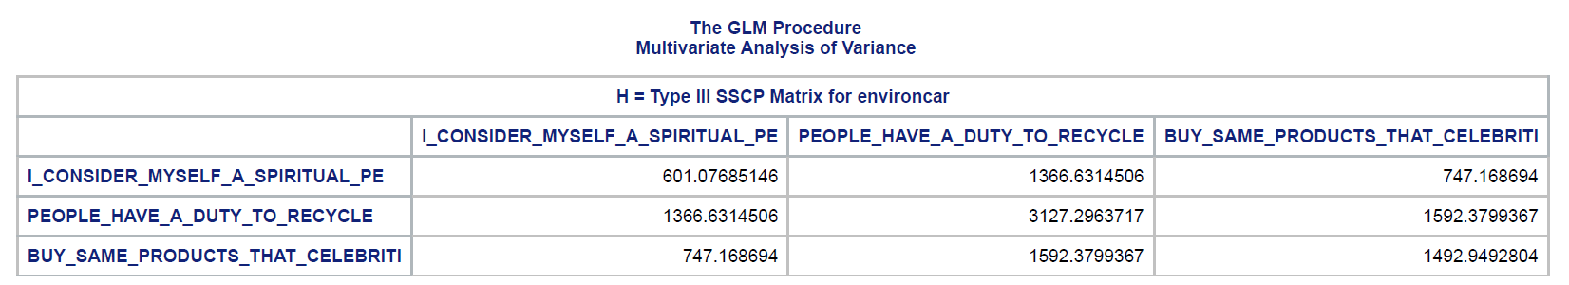
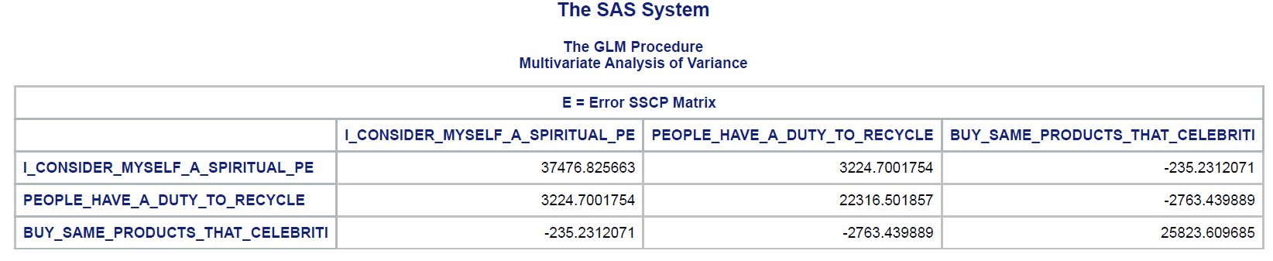
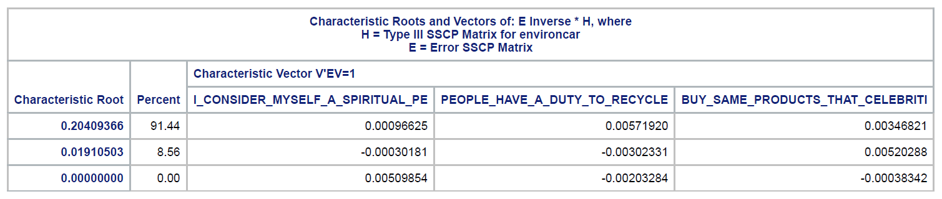
Just in Case You’re Curious
Here are the between and error SCP matrices as well as the eigenvalues (characteristic roots) !

